Slide 1
The Right Time Initiative Evaluation

Slide 2
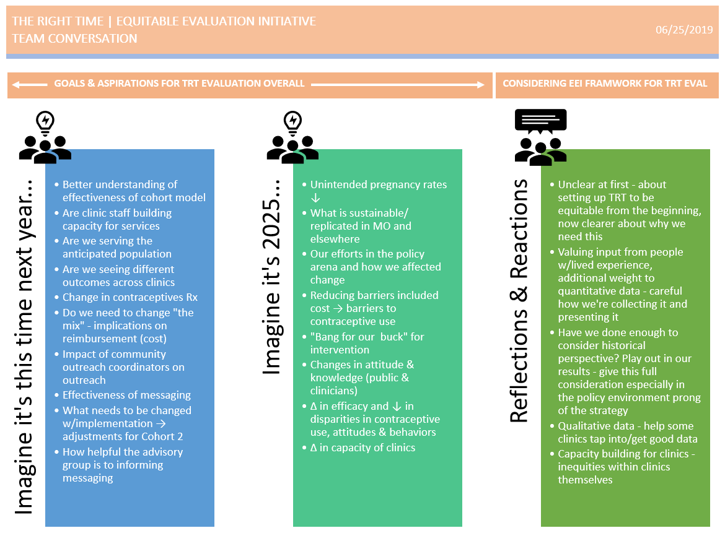

Slide 5
The Right Time Initiative Evaluation

Slide 6
Consider for each evaluation study…
Yellow Post-Its:
Which EE principles does this evaluation already embrace?
How are the EE principals being acted out?
Pink Post-Its:
In order to embrace EE principals what needs to change?
What challenges will we have to overcome?

Slide 7
Next Steps…
Process all the ideas/discussion from today
Pull out non-evaluation related ideas for future consideration/discussion
Consider timing and prioritization for possible changes/tweaks to the evaluation plan
Identify when and how to appropriately engage initiative partners
Bring back a proposed course of action to the full team (Aug/Sept)

